Slide 1
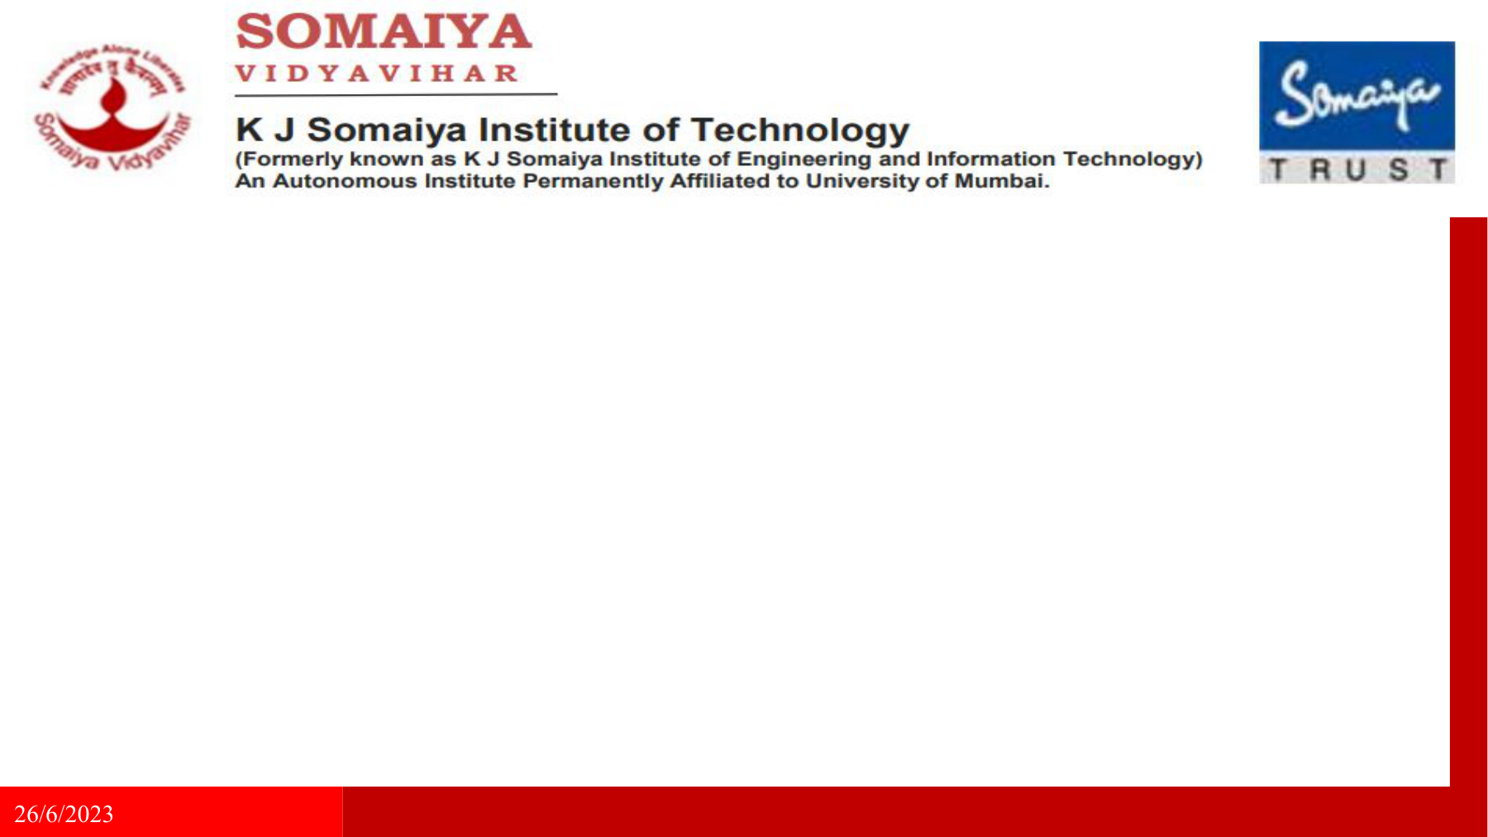
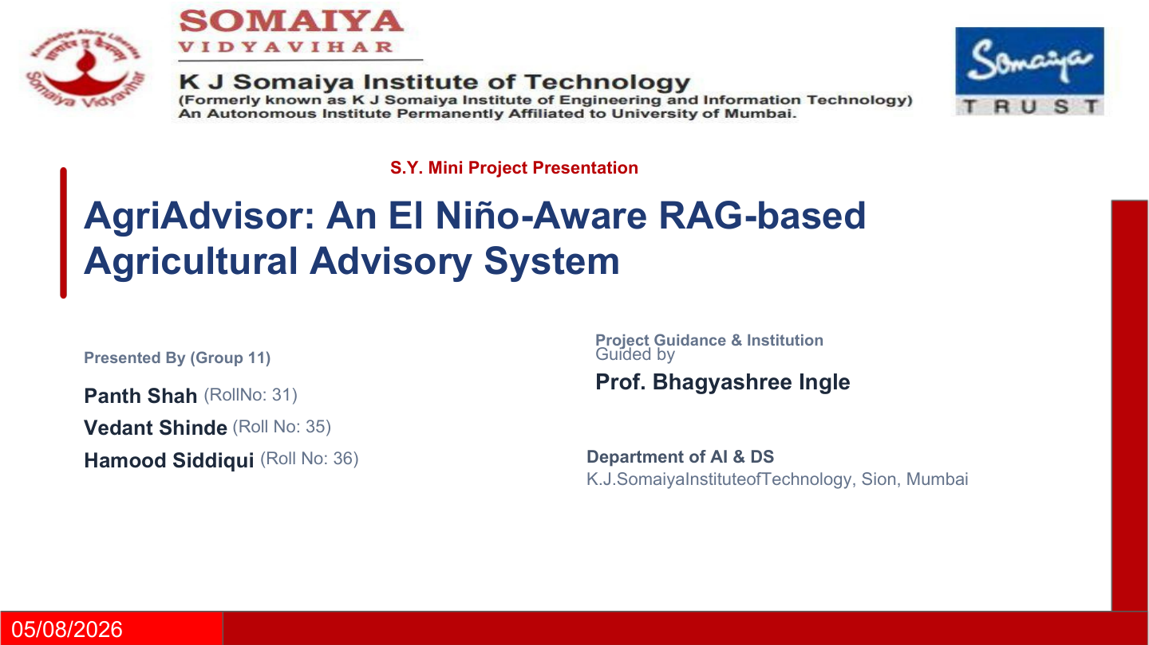
S.Y. Mini Project Presentation
AgriAdvisor: An El Niño-Aware RAG-based
Agricultural Advisory System
PROJECT GUIDE
PRESENTED BY — GROUP 9
Guided by
Panth Shah
(Roll No: 31)
Prof. Bhagyashree Ingle
Vedant Shinde
(Roll No: 35)
Hamood Siddiqui
(Roll No: 36)
Department of AI & DS
K.J. Somaiya Institute of Technology, Sion, Mumbai
05/08/2026

Slide 2
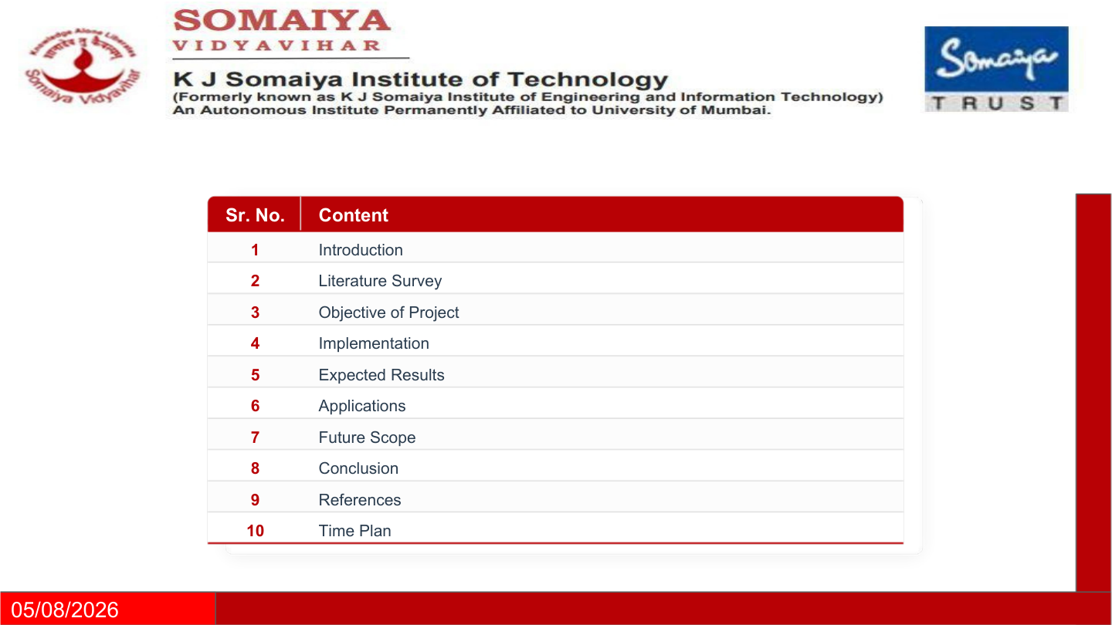
Sr. No. | Content
1 | Introduction
2 | Literature Survey
3 | Objectives
4 | Proposed Methodology & System Architecture
5 | Tools, Technologies & Resources
6 | Work Completed So Far
7 | Final / Expected Outcomes
8 | Applications & Future Scope
9 | Timeline
10 | References
05/08/2026

Slide 3
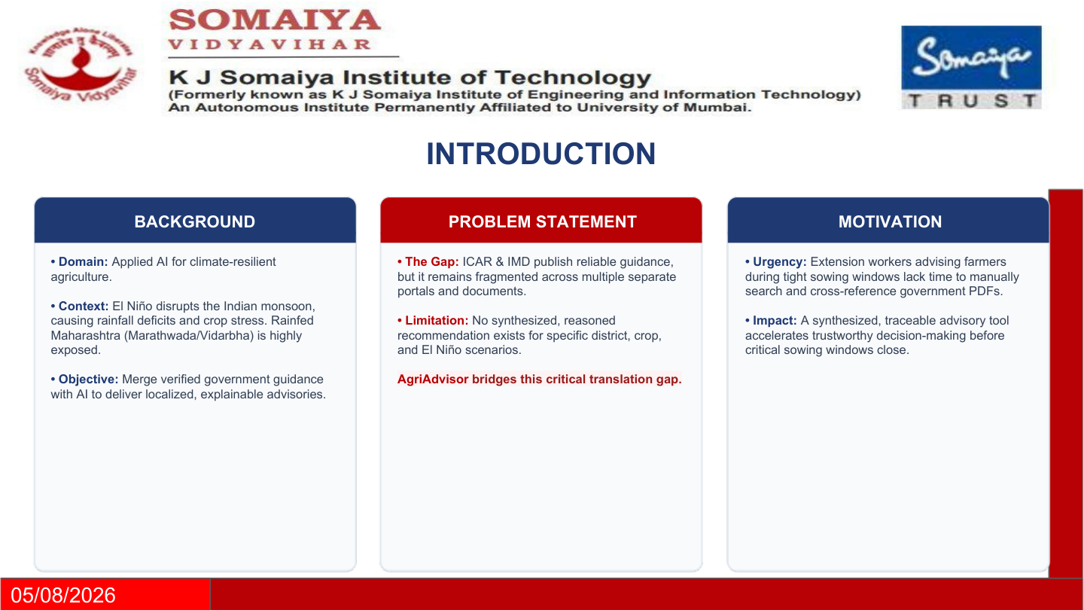
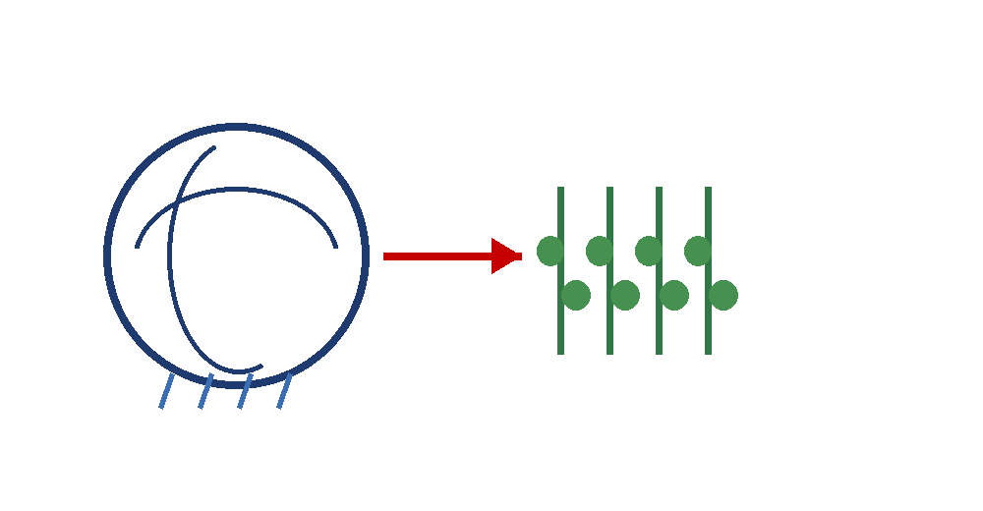

INTRODUCTION
Background
• Domain: Applied AI for climate-resilient agriculture.
• El Niño can disrupt the Indian monsoon, causing rainfall deficits and crop stress across rainfed Maharashtra.
• AgriAdvisor combines verified government guidance with AI retrieval to produce localized, explainable advisories.
CLIMATE SIGNAL
El Niño / ENSO
↓
LOCAL CONTEXT
Problem Statement
District • Crop • Month
↓
• ICAR, IMD and climate-science sources publish reliable information, but it is fragmented across documents and portals.
• Extension workers need district-, crop- and scenario-specific guidance without manually searching multiple sources.
• General-purpose LLMs can be fluent without being grounded in the relevant official guidance.
ACTIONABLE ADVISORY
Recommendation → Reason → Source
05/08/2026

Slide 4
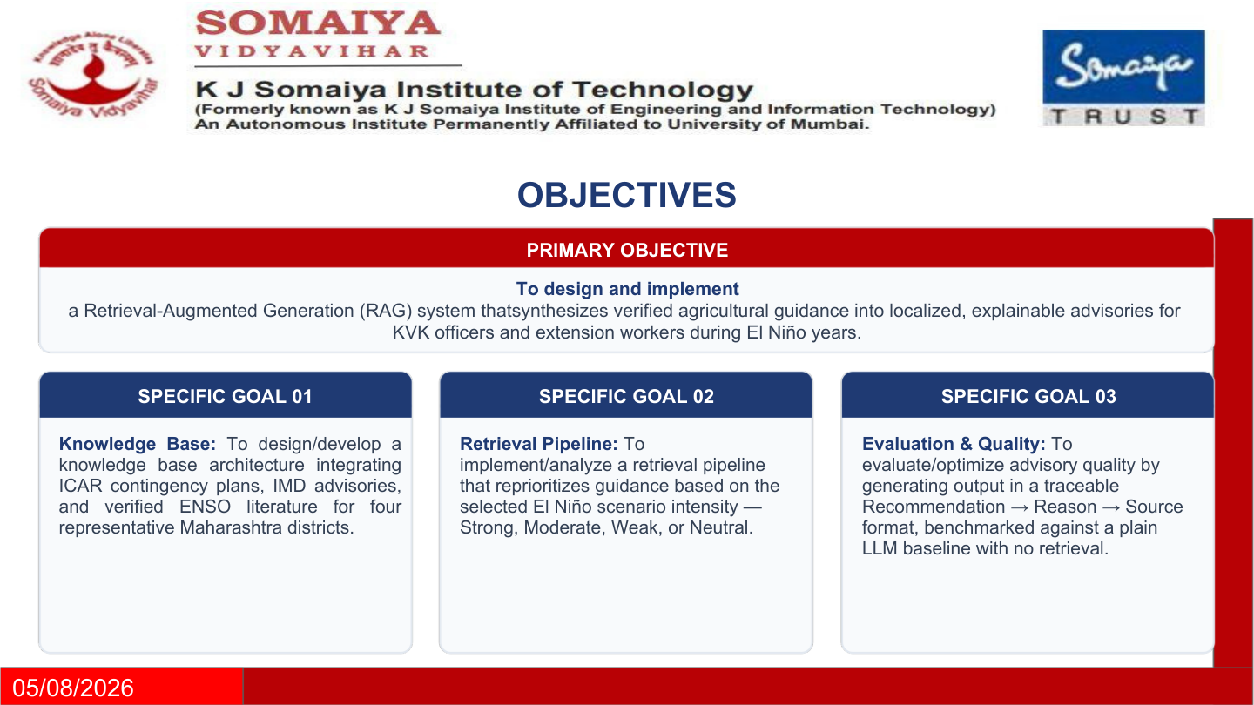
OBJECTIVES
Primary Objective
Design and implement a Retrieval-Augmented Generation (RAG) system that synthesizes verified agricultural guidance into localized, explainable advisories for KVK officers and extension workers during El Niño scenarios.
Specific Goals
• Build a curated knowledge base using ICAR contingency plans, IMD advisories and verified ENSO literature.
• Retrieve guidance using district, crop, month and El Niño scenario as context.
• Generate traceable output in the format Recommendation → Reason → Source.
• Evaluate the grounded system against a plain LLM baseline.
05/08/2026

Slide 5
LITERATURE SURVEY
Author(s) & Year | Paper Title | Method / Technique | Objective | Limitations | Key Findings | Research Gap
Soni, A.K., Tripathi, J.N., Sateesh, M. (2025) | Impact of soil moisture and rainfall variability on soybean crop yield during El Niño episodes in Maharashtra, India | GLDAS soil moisture + IMD rainfall; zonal statistics; Mann–Kendall trend test | Quantify El Niño effects on soil moisture, rainfall and soybean yield in Marathwada and Vidarbha | Sub-regional correlation differs; GLDAS resolution limits | Very strong El Niño: Marathwada −40% rainfall / −70% yield; Vidarbha −7% / −57% | Supports district-specific advisory logic rather than one uniform rule
Athira, K.S., Roxy, M.K., Dasgupta, P., Saranya, J.S., Singh, V.K., Attada, R. (2023) | Regional and temporal variability of Indian summer monsoon rainfall in relation to El Niño Southern Oscillation | PCA-Biplot analysis; 1901–2018 historical time series | Understand regional and temporal changes in ENSO–monsoon relationship | Coordinate boxes are not administrative districts | ENSO–monsoon relationship varies regionally and has weakened nationally since 1981 | Justifies region-aware retrieval and geographic mapping
05/08/2026

Slide 6
LITERATURE SURVEY
Author(s) & Year | Paper Title | Method / Technique | Objective | Limitations | Key Findings | Research Gap
Hill, S.A. et al. (2025) | More extreme Indian monsoon rainfall in El Niño summers | Observational rainfall analysis; 1901–2020 | Determine El Niño effects on total and extreme daily monsoon rainfall | National-scale; not district-specific | El Niño lowers seasonal rainfall but can increase extreme daily rainfall risk | Advisories need separate deficit and extreme-rain warnings
Gurazada, M. et al. (2024) | El Niño and positive Indian Ocean Dipole conditions simultaneously reduce the production of multiple cereals across India | Climate indices + crop-production analysis | Assess combined ENSO/IOD effects on cereal production | Production-level analysis does not directly generate advisories | Combined climate anomalies can reduce multiple cereal yields | Motivates multi-source climate context in agricultural decisions
05/08/2026

Slide 7
EXISTING SYSTEMS & RESEARCH GAP
EXISTING SYSTEM 1
EXISTING SYSTEM 2
RAG-based LLM Advisory Framework
Terna Engineering College, Navi Mumbai
• Uses Retrieval-Augmented Generation over Package of Practices documents for agricultural advisory.
• Covers multiple crops and compares different LLM approaches.
Limitation:
Does not explicitly use El Niño / ENSO scenario intensity as a retrieval-weighting variable.
SukhaRakshak AI
International Water Management Institute (IWMI)
• AI-based drought advisory approach involving drought indicators, contingency plans and multilingual delivery.
• Intended for farmers, extension officers and drought managers.
Limitation:
Focuses on general drought severity rather than explicit El Niño scenario-intensity retrieval.
RESEARCH GAP
Neither system makes El Niño scenario intensity an explicit retrieval-weighting variable.
AgriAdvisor combines verified government contingency plans, weather advisories and climate science
with scenario-aware retrieval to generate district-, crop- and month-specific recommendations.
05/08/2026

Slide 8
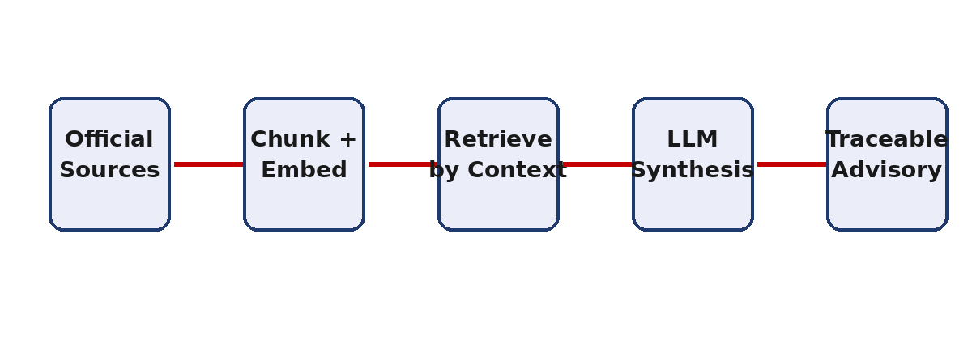
METHODOLOGY & ARCHITECTURE
Goal:
Generate a localized, explainable agricultural advisory from verified sources.
Approach
• Ingestion: ICAR contingency plans + IMD agromet advisories + ENSO literature.
• Preprocessing: semantic chunking, metadata tagging and embeddings.
• Retrieval: district + crop + month + scenario-aware search.
• Generation: local LLM produces Recommendation → Reason → Source.
District / Crop /
Month / Scenario
Retrieve relevant
chunks
Generate + cite
source
The retrieval layer is the project’s differentiator: the same question can surface different guidance when the climate scenario changes.
05/08/2026

Slide 9
SYSTEM ARCHITECTURE
DATA SOURCES
ICAR Plans
INGESTION +
PREPROCESSING
CONTEXT
BUILDER
VECTOR
RETRIEVER
LOCAL LLM
GENERATOR
IMD Advisories
Chunking
Metadata
Embeddings
District
Crop
Month
Scenario
Scenario-weighted
relevant chunks
Recommendation
Reason
Source
ENSO Literature
End-to-end traceability: every generated recommendation is anchored to retrieved source material.
05/08/2026

Slide 10
TOOLS, TECHNOLOGIES & RESOURCES
Software & AI Stack
Knowledge Sources
Representative Districts
• Python — core implementation
• LangChain — retrieval orchestration
• Ollama — local LLM inference
• ChromaDB — vector database
• Streamlit — prototype interface
• ICAR district contingency plans
• IMD Agromet Advisory Bulletins
• NOAA ONI / ENSO classification
• Peer-reviewed ENSO–India literature
• Latur
• Beed
• Yavatmal
• Amravati
05/08/2026

Slide 11
WORK COMPLETED SO FAR
Scope & Data
PROJECT STATUS
Scope
DONE
• Finalized problem scope, primary users, inputs and outputs.
• Selected four representative Maharashtra districts.
• Collected ICAR contingency plans and IMD advisory material.
Data Collection
DONE
Architecture
DONE
Research & Design
• Built the requirements / knowledge-source matrix.
• Reviewed ENSO–monsoon and agricultural-impact literature.
• Defined scenario-aware retrieval and traceable output format.
Core RAG
NEXT
Evaluation
NEXT
Current emphasis → implement the retrieval layer, connect the UI, and evaluate grounding against a plain LLM baseline.
05/08/2026

Slide 12
FINAL / EXPECTED OUTCOMES
Working Prototype
QUESTION
RETRIEVE
ADVISE
• Streamlit-based advisory interface.
• District + crop + month + scenario inputs.
• Grounded response with Recommendation → Reason → Source.
SOURCE
REASON
Research Contribution
• Explicitly links El Niño scenario intensity to retrieval priority.
• Unifies government contingency plans, agromet advisories and climate literature.
• Creates a reproducible, explainable advisory pipeline.
Expected result: faster, more consistent and more defensible climate-aware agricultural guidance.
05/08/2026

Slide 13
APPLICATIONS & FUTURE SCOPE
Applications
Future Scope
• KVK officers and agricultural extension workers
• District-level crop planning during El Niño years
• Pre-sowing advisories and contingency-plan retrieval
• Decision support for localized climate-risk communication
• Live IMD / weather feeds for dynamic context
• More districts, crops and regional languages
• Hybrid retrieval + reranking for stronger evidence selection
• Automated evaluation using citation correctness and groundedness
• Deployment for mobile / low-bandwidth extension workflows
05/08/2026

Slide 14
TIMELINE
Activity | W1 | W2 | W3 | W4 | W5 | W6 | W7 | W8 | W9 | W10 | W11 | W12 | W13 | W14
Literature Survey
Synopsis Approval
Requirement Gathering
Dataset Collection
System Design
Core Implementation & Coding
Mid-Term Review
Testing & Debugging
Result Analysis
Final Report Writing
Poster Preparation
Final Viva
05/08/2026

Slide 15
REFERENCES — 1 OF 2
[1] A. K. Soni, J. N. Tripathi, and M. Sateesh, "Impact of soil moisture and rainfall variability on soybean crop yield during El Niño episodes in Maharashtra, India," Theor. Appl. Climatol., vol. 156, art. 576, 2025. doi: 10.1007/s00704-025-05829-w
[2] K. S. Athira, M. K. Roxy, P. Dasgupta, J. S. Saranya, V. K. Singh, and R. Attada, "Regional and temporal variability of Indian summer monsoon rainfall in relation to El Niño Southern Oscillation," Sci. Rep., vol. 13, art. 12643, 2023. doi: 10.1038/s41598-023-38730-5
[3] S. A. Hill et al., "More extreme Indian monsoon rainfall in El Niño summers," Science, vol. 389, pp. 1220–1224, 2025. doi: 10.1126/science.adg5577
[4] M. Gurazada et al., "El Niño and positive Indian Ocean Dipole conditions simultaneously reduce the production of multiple cereals across India," Environ. Res. Lett., vol. 19, no. 10, art. 104059, 2024.
[5] N. Subash et al., "Relevance of climatological information on spatial and temporal variability of Indian summer monsoon rainfall in recent El Niño years and its impact on four important kharif crops over India," Clim. Serv., vol. 30, art. 100370, 2023.
[6] S. Sawant, R. Nair, and S. Hariharan, "Empowering farmers with artificial intelligence: a retrieval-augmented generation based large language model advisory framework," J. Agric. Eng., vol. 57, 1908, 2026. doi: 10.4081/jae.2026.1908
05/08/2026

Slide 16
REFERENCES — 2 OF 2
[7] R. Bhatla et al., "El Niño/La Niña and IOD impact on Kharif season crops over Western agro-climatic zones of India," Theor. Appl. Climatol., vol. 151, no. 3–4, pp. 1355–1368, 2023.
[8] S. K. Bal et al., "Weather forecast, agriculture contingency plan and agromet-advisory services for climate resilient agriculture," Indian J. Agron., vol. 66, 5th IAC Special Issue, 2021.
[9] K. K. Kumar et al., "Unraveling the Mystery of Indian Monsoon Failure During El Niño," Science, vol. 314, no. 5796, pp. 115–119, 2006. doi: 10.1126/science.1131152
[10] D. S. Pai and S. Nair, "Impact of El-Niño-Southern Oscillation (ENSO) on extreme temperature events over India," MAUSAM, vol. 73, no. 3, pp. 597–606, 2022. doi: 10.54302/mausam.v73i3.5932
[11] NOAA Climate Prediction Center, "Oceanic Niño Index (ONI)," National Oceanic and Atmospheric Administration.
[12] International Water Management Institute, "India to get its first AI-based chatbot to tackle drought," IWMI Blog, 2025.
05/08/2026

Slide 17

Thank You
Questions & Discussion
AgriAdvisor • Group 9
El Niño-aware • Grounded • Explainable
05/08/2026

